Slide 1
Mastermind
By: Max Marder, Sam Nguon, and Michelle Niland

Slide 2
The Game Itself
Two modes: user mode and comp mode
User mode allows the user to choose their difficulty and try to guess a randomly generated code
Return pegs are in the form of X’s and O’s
The user can also receive help instructions, get a hint, or quit the game altogether
Comp mode has the user enter a secret code that the computer will answer in up to 5 guesses!
Score is calculated at the of the game based on the number of tries and hints used
Notes:
SAM

Slide 3
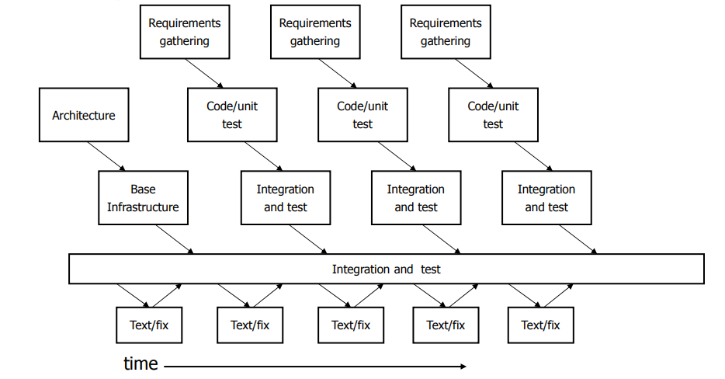
Development Process
General Meeting Flow:
T/TH 2 hour meetings
Group debugging
Requirements gathering
Design/Implementation
Division of labor
Between Meetings:
Solo code
Unit Testing/Debugging
Integration
Notes:
MAX

Slide 4
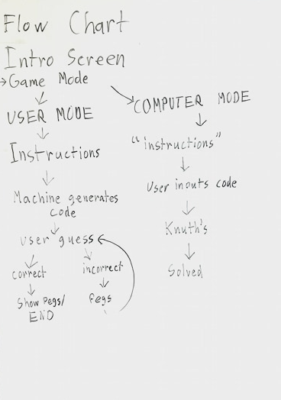
Design Choices
Python: great for strings!
Using snake case, ## TEST tags, plenty of comments, descriptive variable names, and organized code structure
Two files: one for the main code, other for the game text
Notes:
MICHELLE

Slide 5
What Worked Well
Communication- Facebook Messenger
Group Meetings
Coding Conventions
Group Bug Testing
Notes:
SAM

Slide 6
Things to Improve
More pythonic code
More professional communication platform like Slack
Git instead of Google Drive
Notes:
MAX

Slide 7
Demo Time!

